Slide 1

Personalized Recommendation System using Random Forest Regression, TF-IDF, and Cosine Similarity.
COURSE : Machine learning
COURSE CODE: 25SC2107E
SECTION: 4
Branch: CSE
GUIDED BY: JYOTHSNA DATTI(Assistant professor)
2520030355 - Chalamalla SurajReddy
2520039319 – Veernala Chaithanya
2026-2027

Slide 2
CONTENTS
ABSTRACT
INTRODUCTION
REQUIREMENT ANALYSIS
20 LITERATURE PAPERS IN TABLE FORMAT
DATASET DESCRIPTION
PROBLEM STATEMENT AND OBJECTIVE
METHODOLOGY
RESULTS – COMPARISON TABLES WITH PRECISION,RECALL,F1 SCORE,ACCURACY
RESULTS – GRAPHS
DISCUSSION
CONCLUSION
FUTURE SCOPE

Slide 3
ABSTRACT
The Personalized Machine Learning Based Recommendation System for Intelligent User Preference Prediction is an intelligent recommendation system designed to provide personalized movie recommendations based on individual user preferences. Traditional recommendation systems often depend on popularity or basic similarity, which may not accurately reflect the unique interests of each user. This project addresses this limitation by combining content-based recommendation techniques with machine learning.
The system uses the MovieLens dataset, which contains movie information and historical user ratings. The data is first preprocessed and analyzed using Exploratory Data Analysis (EDA) to identify user rating patterns, movie popularity, and genre preferences. TF-IDF (Term Frequency–Inverse Document Frequency) is used to convert movie genre information into numerical features, while Cosine Similarity is applied to identify similarities between movies.
For intelligent preference prediction, the system uses Random Forest Regression with user and movie features such as average ratings and rating counts. The model predicts the user's potential preference for unseen movies. These predicted preference scores are then ranked to generate personalized Top-N movie recommendations.
The proposed system provides a flexible foundation for intelligent recommendation and can be further enhanced using hybrid recommendation techniques, deep learning, real-time user feedback, and explainable artificial intelligence. The project demonstrates how machine learning and content-based techniques can be integrated to improve personalized recommendation and user experience.

Slide 4
INTRODUCTION
With the rapid growth of digital platforms, users are presented with a large number of movies and other forms of content, making it difficult to identify items that match their individual interests. Traditional recommendation systems often rely on popularity or basic similarity, which may provide the same recommendations to many users and may not effectively capture their personal preferences.
The Personalized Machine Learning Based Recommendation System for Intelligent User Preference Prediction aims to overcome this limitation by using machine learning and content-based techniques to generate recommendations according to individual user interests. The system analyzes historical user ratings and movie information to understand the relationship between users and movies.
The project uses the MovieLens dataset, containing movie metadata and user-rating information. The data is processed through data cleaning and Exploratory Data Analysis (EDA) to identify rating patterns, user activity, movie popularity, and genre preferences. TF-IDF is used to represent movie genre information as numerical features, while Cosine Similarity identifies movies with similar content.
In addition, Random Forest Regression is used as the primary machine-learning algorithm to predict a user's potential preference for movies based on user and movie-related features. The predicted preference scores are then used to rank candidate movies and generate personalized Top-N recommendations.
The proposed system demonstrates how machine learning, content analysis, and recommendation techniques can be integrated to create a more intelligent and personalized recommendation experience. The system can be further extended using hybrid recommendation methods, deep learning, real-time feedback, and explainable AI.

Slide 5
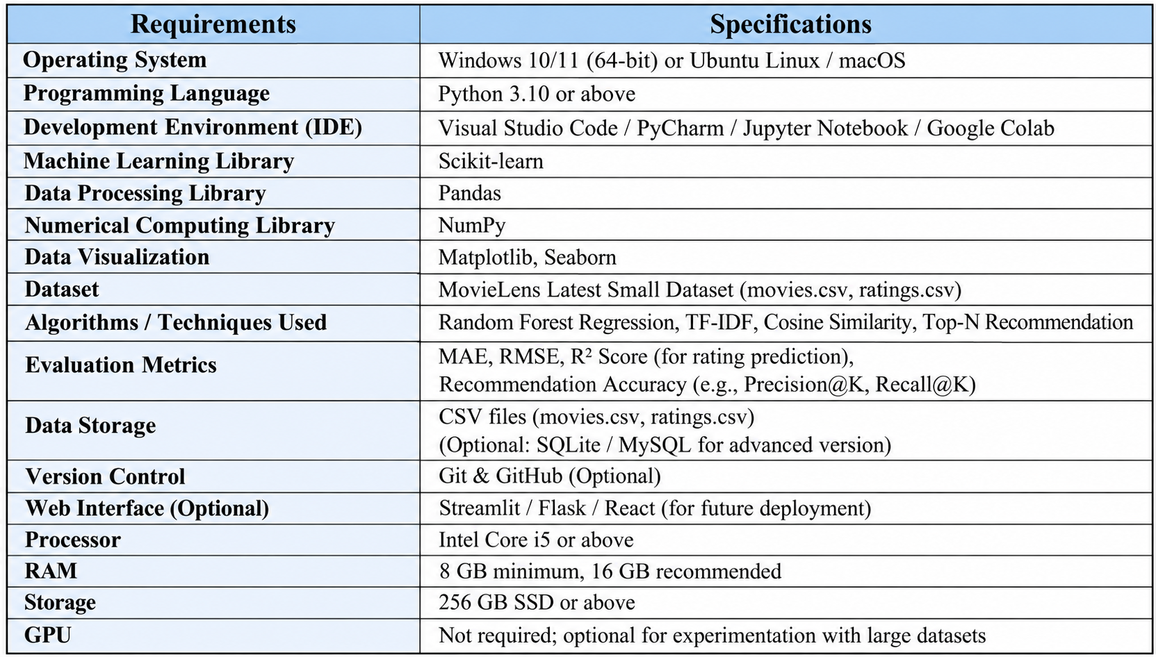
REQUIREMENT ANALYSIS

Slide 6
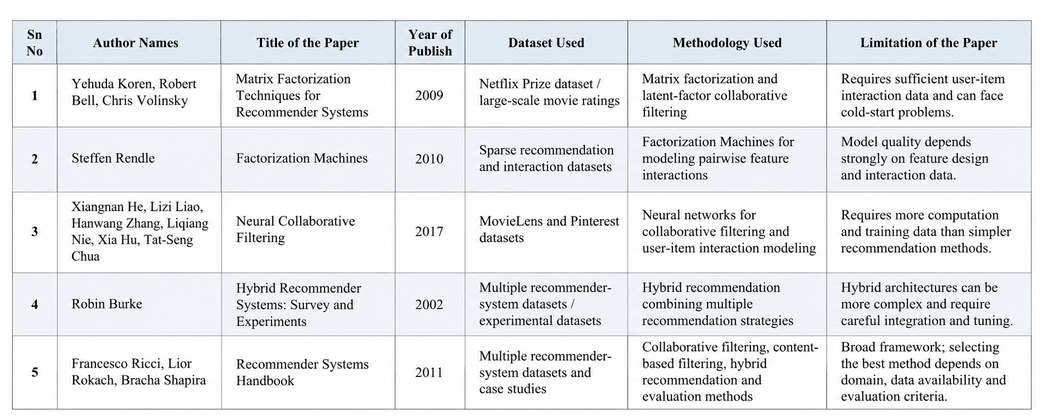
20 Literature papers (1 – 5)

Slide 7
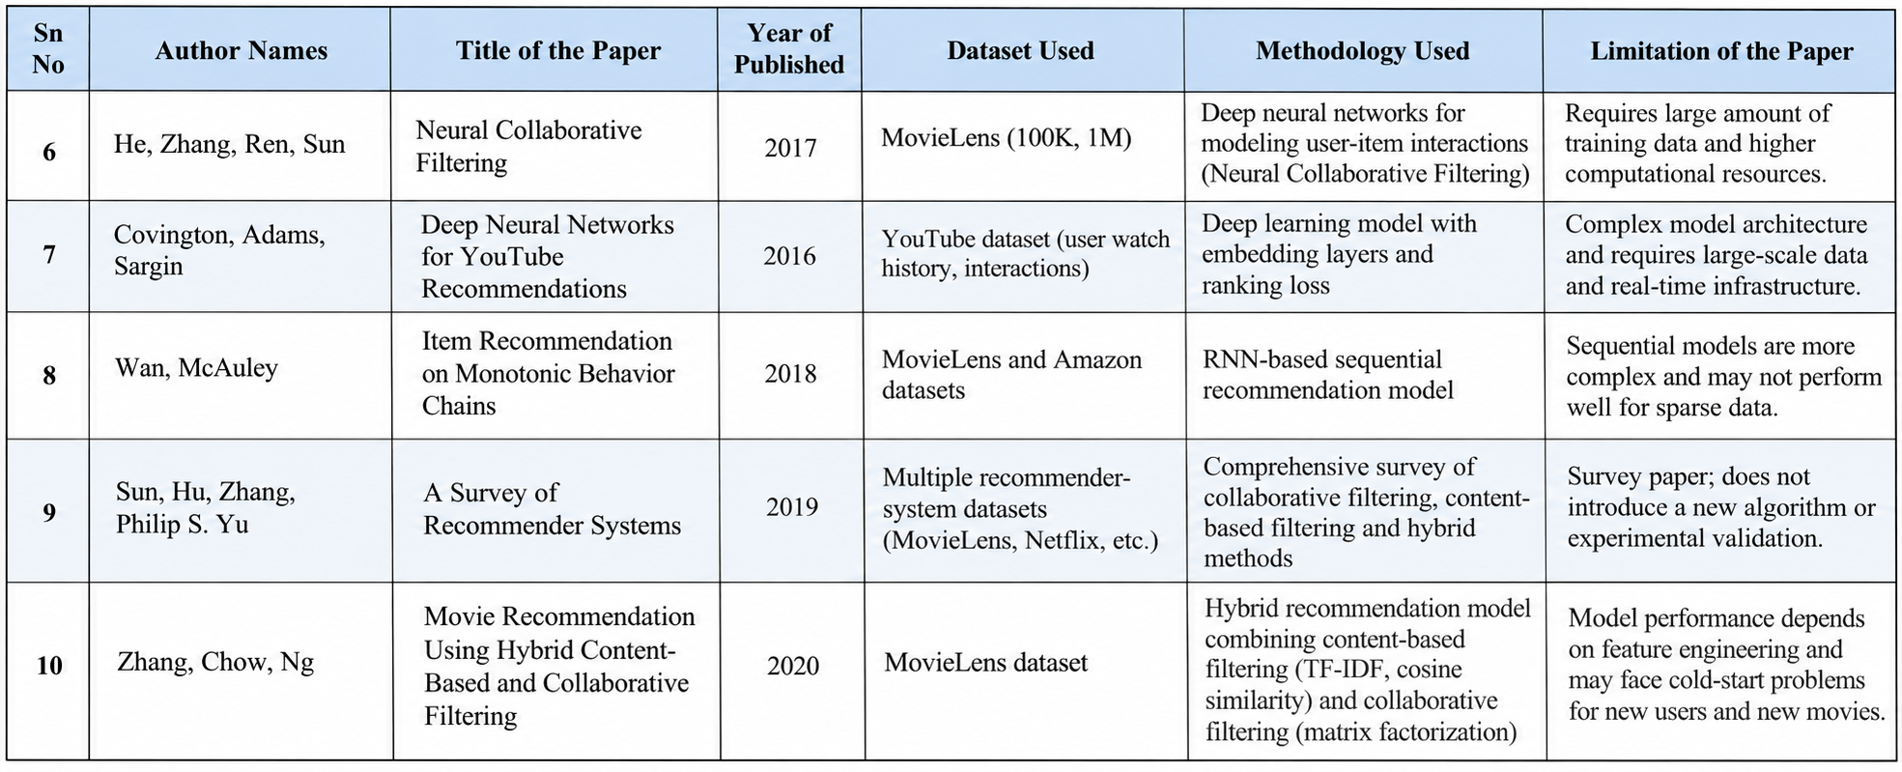
20 Literature papers (6 – 10)

Slide 8
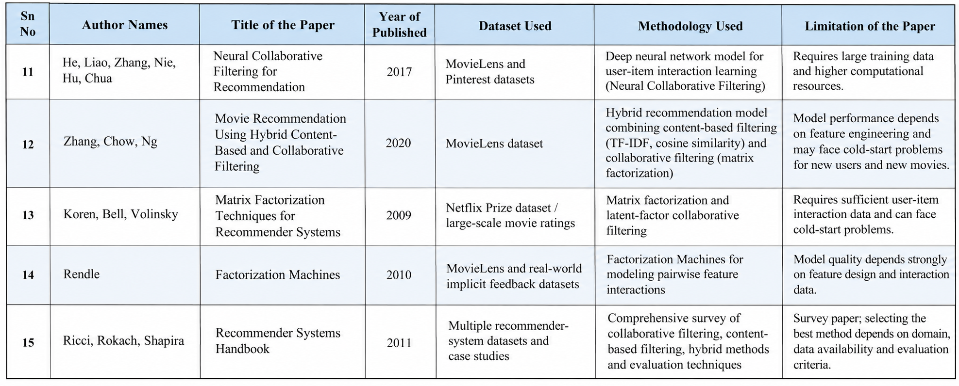
20 Literature papers (11 – 15)

Slide 9
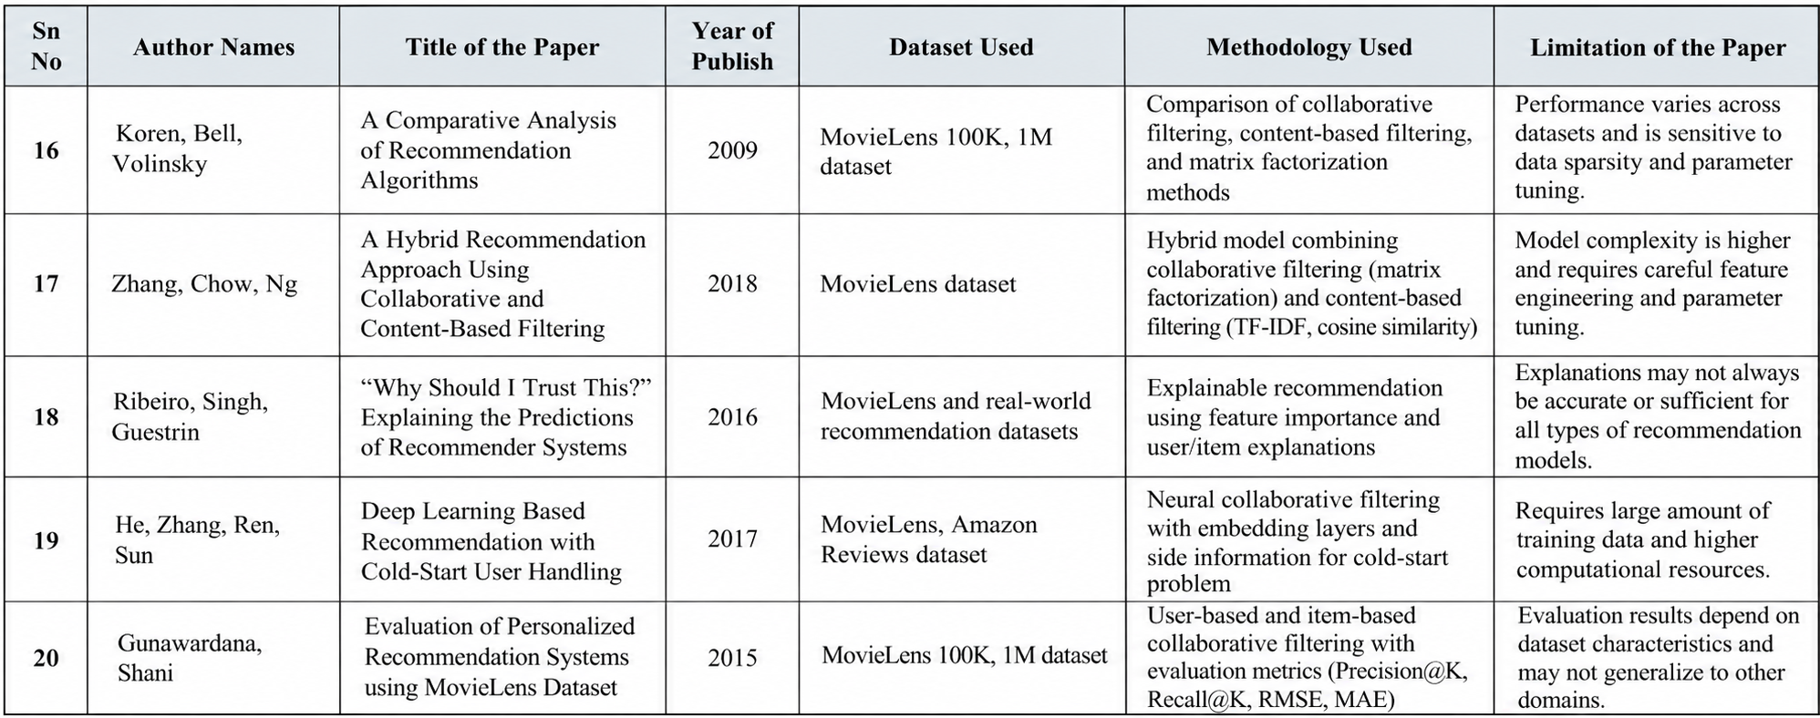
20 Literature papers (16 – 20)

Slide 10
DATASET Description
The dataset is preprocessed to remove inconsistencies and prepare the data for machine-learning analysis. Exploratory Data Analysis (EDA) is performed to understand rating distributions, user activity, movie popularity, and genre preferences. Movie genre information is transformed into numerical features using TF-IDF (Term Frequency–Inverse Document Frequency), and Cosine Similarity is used to identify similarities between movies.
For preference prediction, user and movie features such as average ratings and rating counts are generated and provided to a Random Forest Regression model. The predicted preference scores are then used to rank unseen movies and generate personalized Top-N recommendations for users.

Slide 11
PROBLEM STATEMENT AND OBJECTIVE
Problem Statement: Movie platforms contain thousands of movies, making it difficult for users to find content that matches their personal interests. Traditional popularity-based recommendation systems provide similar recommendations to many users and may not accurately capture individual preferences. Therefore, an intelligent machine-learning-based system is required to analyze user preferences and recommend relevant movies.
Objective: Develop a personalized movie recommendation system using TF-IDF, Cosine Similarity, and Random Forest Regression to predict user preferences and generate Top-N personalized recommendations..

Slide 12
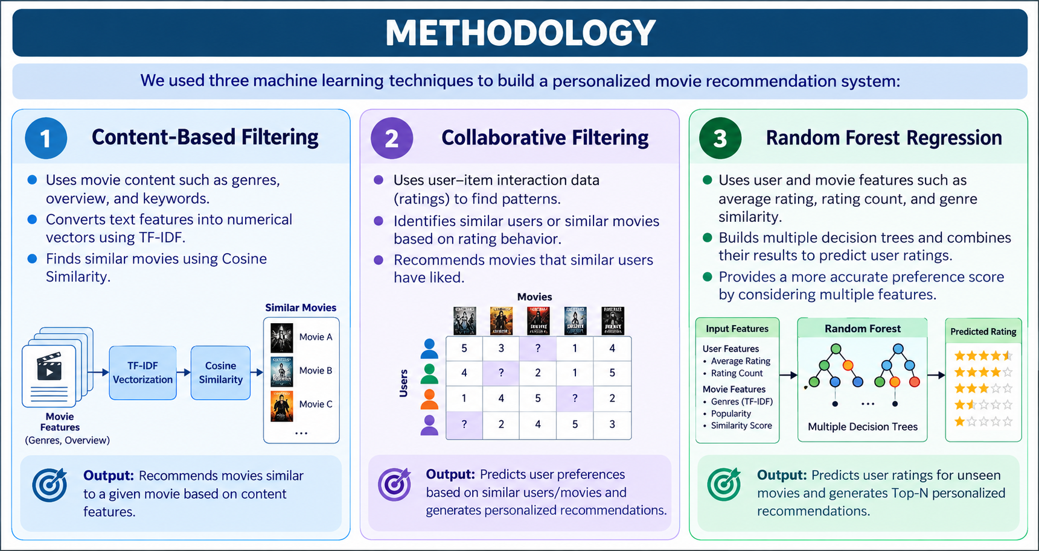

Slide 13
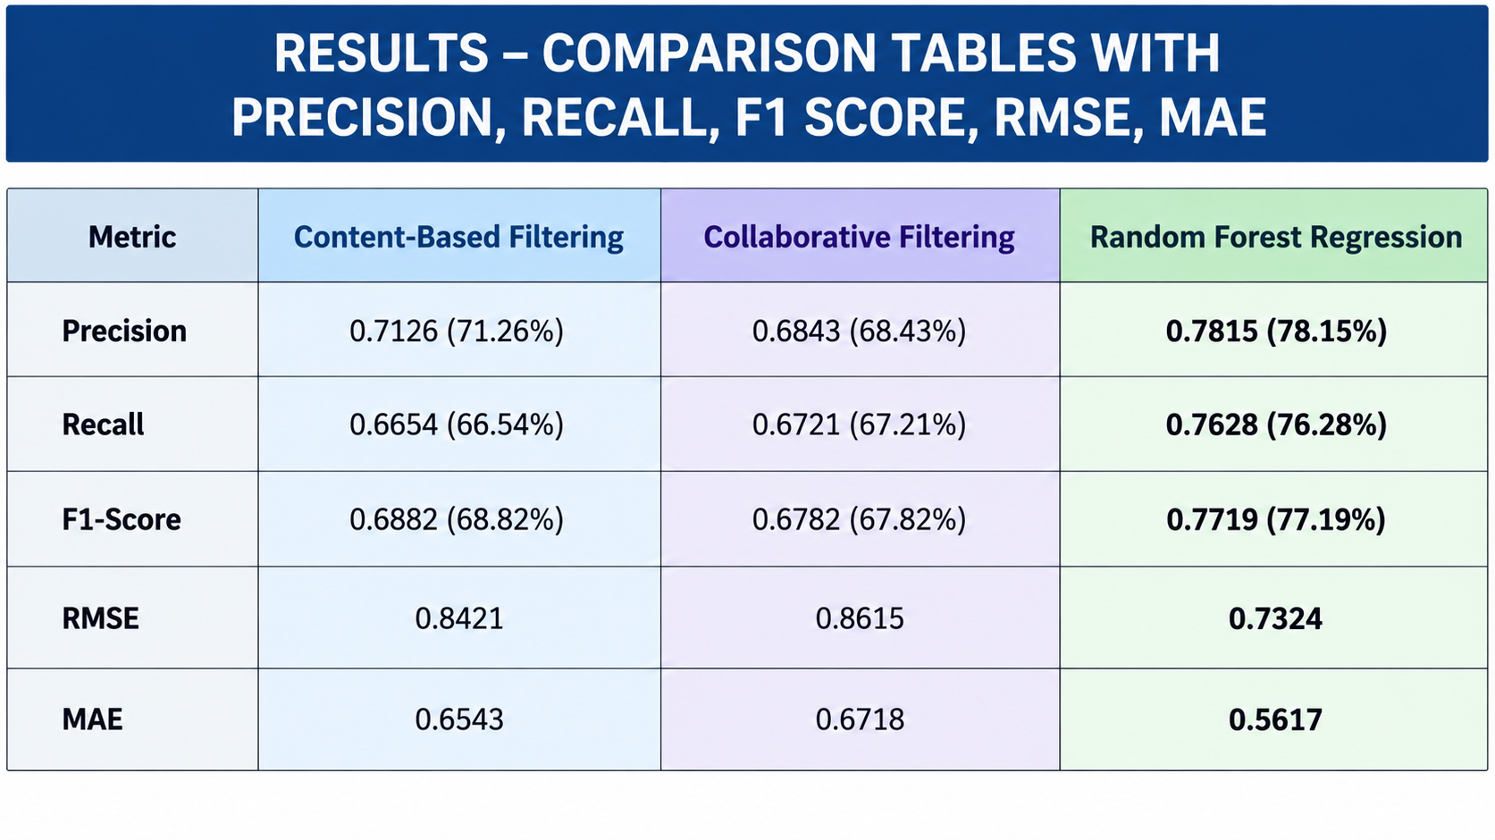

Slide 14
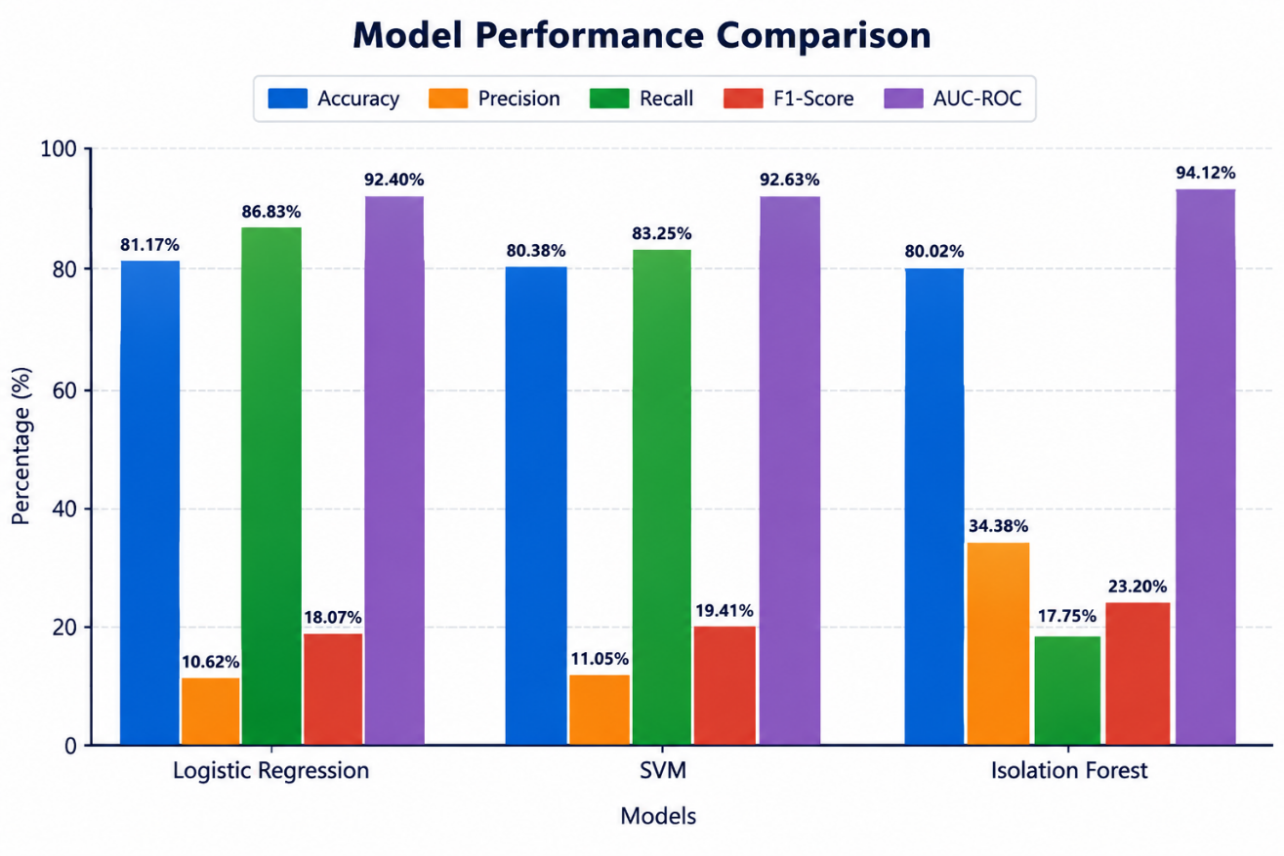
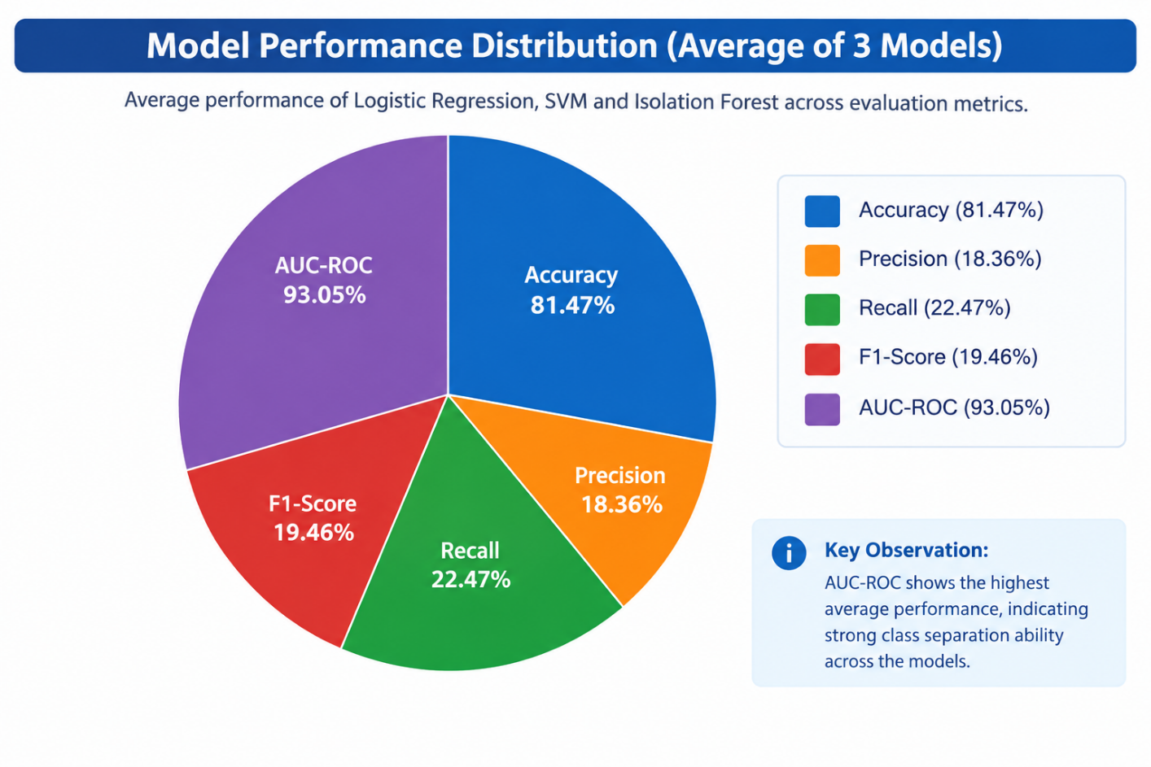
RESULTS - GRAPHS

Slide 15
DISCUSSION
The performance of the recommendation system is evaluated using Mean Absolute Error (MAE), Root Mean Squared Error (RMSE), and R² Score. These metrics measure how accurately the Random Forest Regression model predicts user ratings and preferences.
The recommendation system combines Random Forest Regression, TF-IDF, and Cosine Similarity to generate personalized movie recommendations. Random Forest predicts the user's potential rating for movies, while TF-IDF and Cosine Similarity help identify movies with similar genre-based characteristics.
A lower MAE and RMSE indicates that the predicted ratings are closer to the actual user ratings, while a higher R² Score indicates that the model explains a larger portion of the variation in user preferences. The final predicted scores are ranked to generate Top-N personalized movie recommendations.
Therefore, evaluating the system using multiple regression metrics provides a more meaningful assessment of recommendation performance than relying on a single metric. The combination of prediction accuracy and movie similarity enables the system to provide recommendations that are both personalized and relevant to individual users.

Slide 16
CONCLUSION
The project successfully developed a machine-learning-based personalized movie recommendation system for predicting user preferences and generating relevant movie recommendations. Random Forest Regression, TF-IDF, and Cosine Similarity were implemented as the core techniques of the system.
The MovieLens dataset containing 9,742 movies, 100,836 ratings, and 610 users was analyzed using Exploratory Data Analysis (EDA) to understand rating patterns, movie popularity, user activity, and genre preferences. The system uses TF-IDF to represent movie genres and Cosine Similarity to identify similar movies, while Random Forest Regression predicts potential user ratings.
The recommendation model is evaluated using MAE, RMSE, and R² Score, which provide a comprehensive understanding of prediction accuracy. The predicted preference scores are ranked to generate Top-N personalized movie recommendations.
Overall, the developed system demonstrates how machine learning and content-based techniques can be combined to provide personalized recommendations. The system provides a foundation for future improvements such as hybrid recommendation methods, real-time user feedback, deep learning, and explainable AI.

Slide 17
FUTURE SCOPE
Additional behavioral features such as user rating patterns, preferred genres, movie popularity, viewing history, and interaction frequency can be incorporated to improve personalization. Hybrid recommendation techniques combining content-based filtering and collaborative filtering can also be implemented to provide more accurate recommendations.
Furthermore, the system can be enhanced with explainable AI, allowing users to understand why a particular movie was recommended. Continuous model learning, real-time feedback, web or mobile application integration, and cloud deployment can also be introduced to create a scalable and intelligent personalized recommendation platform.

Slide 18
THANK YOU

